Slide 1
Data Visualisation

Slide 2


Slide 3
Content
General data visualisation tips
Visualising data in R with ggplot2
Materials found in: https://github.com/ClinicianCoders/ClinicianCoders

Slide 4

Notes:
We are going to go through the principles of data vis. Clarity, simplicity, message. Using ggplot2, a package form tidyverse

Slide 5
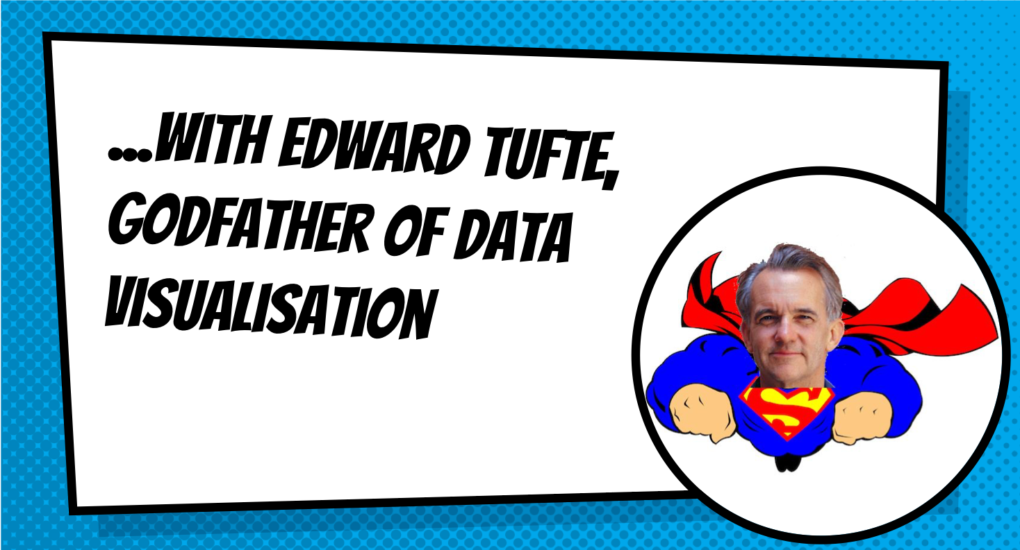

Slide 6
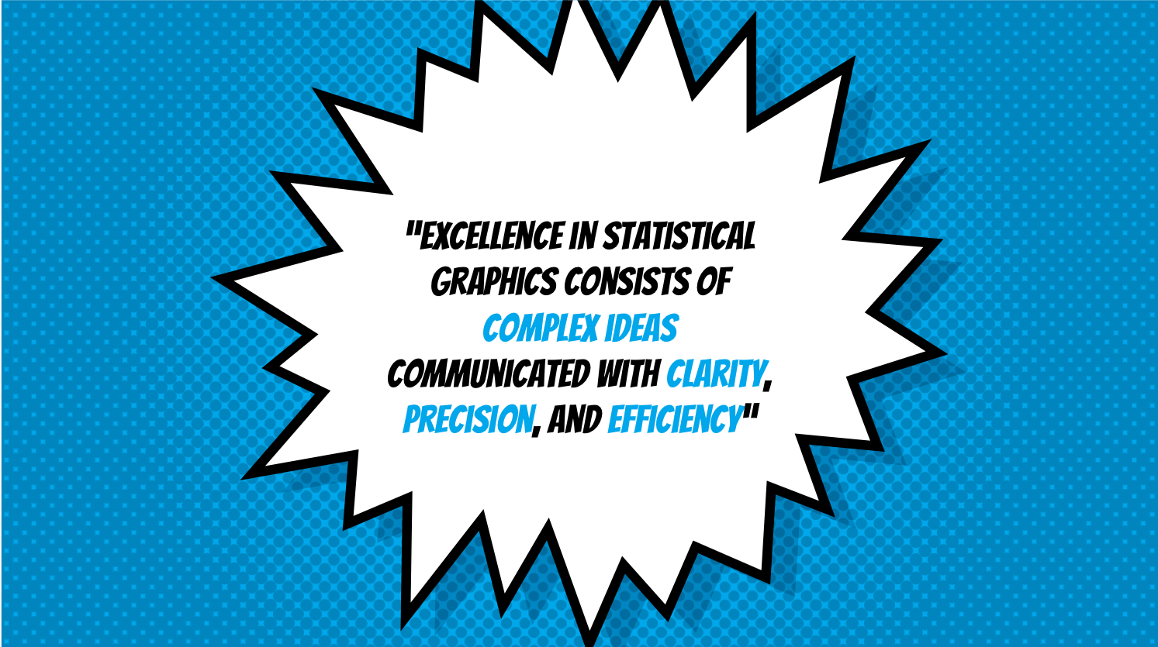

Slide 7
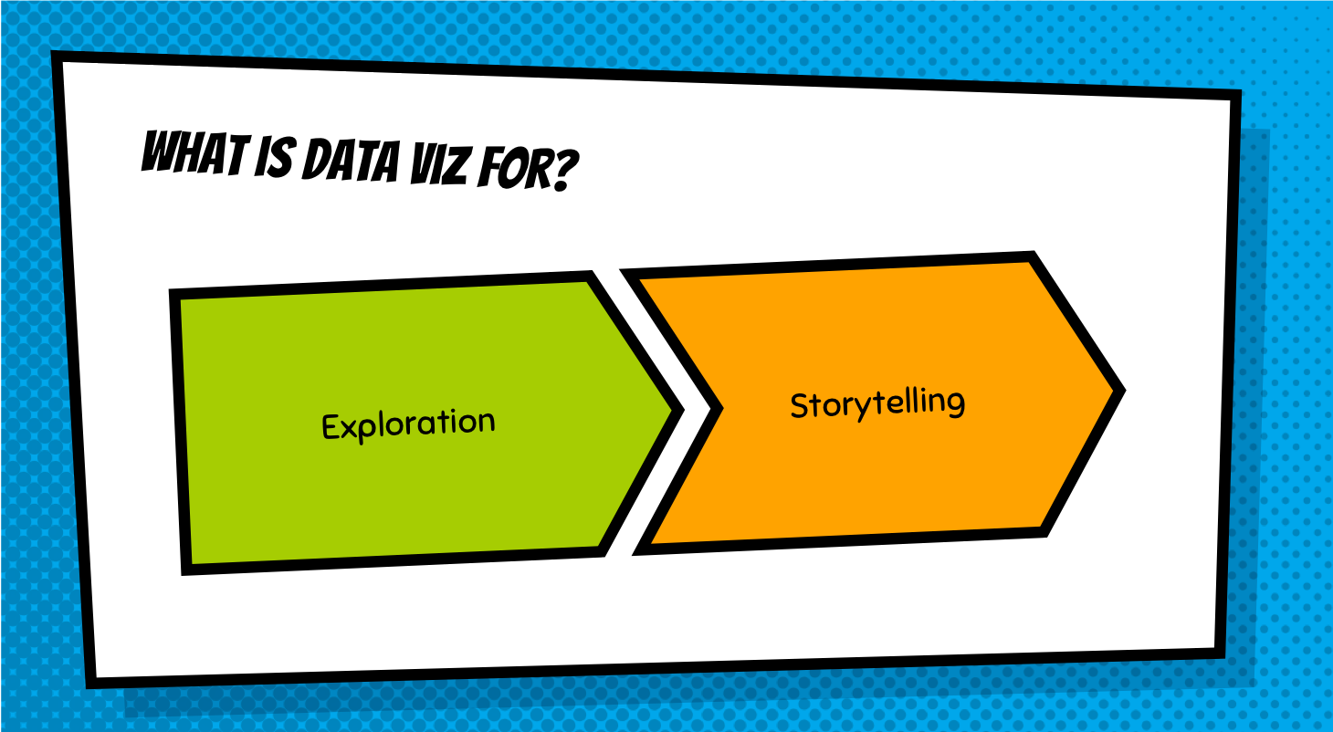

Slide 8


Slide 9
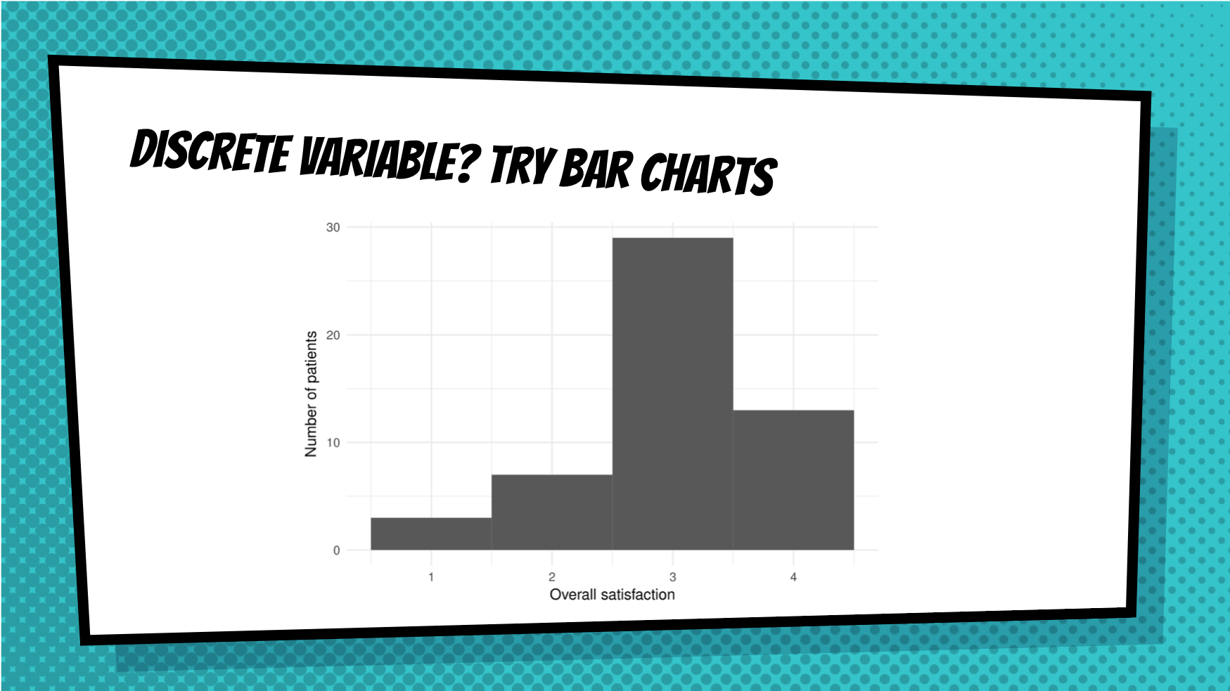

Slide 10
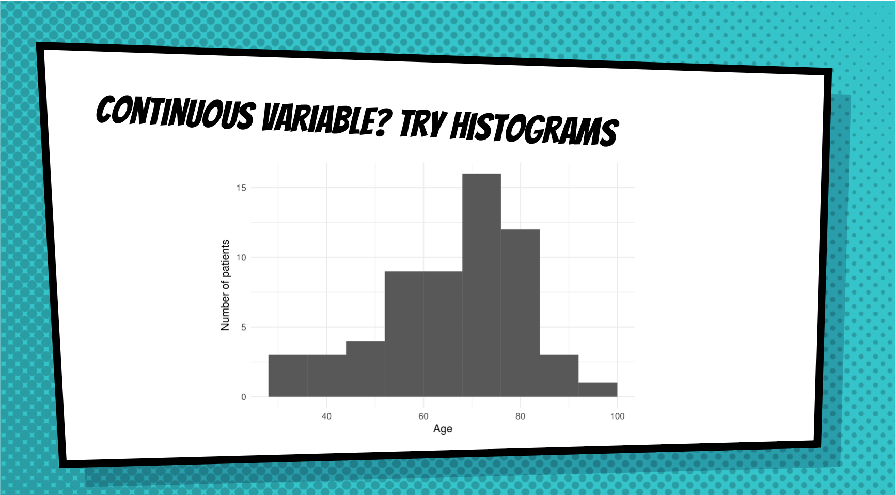

Slide 11
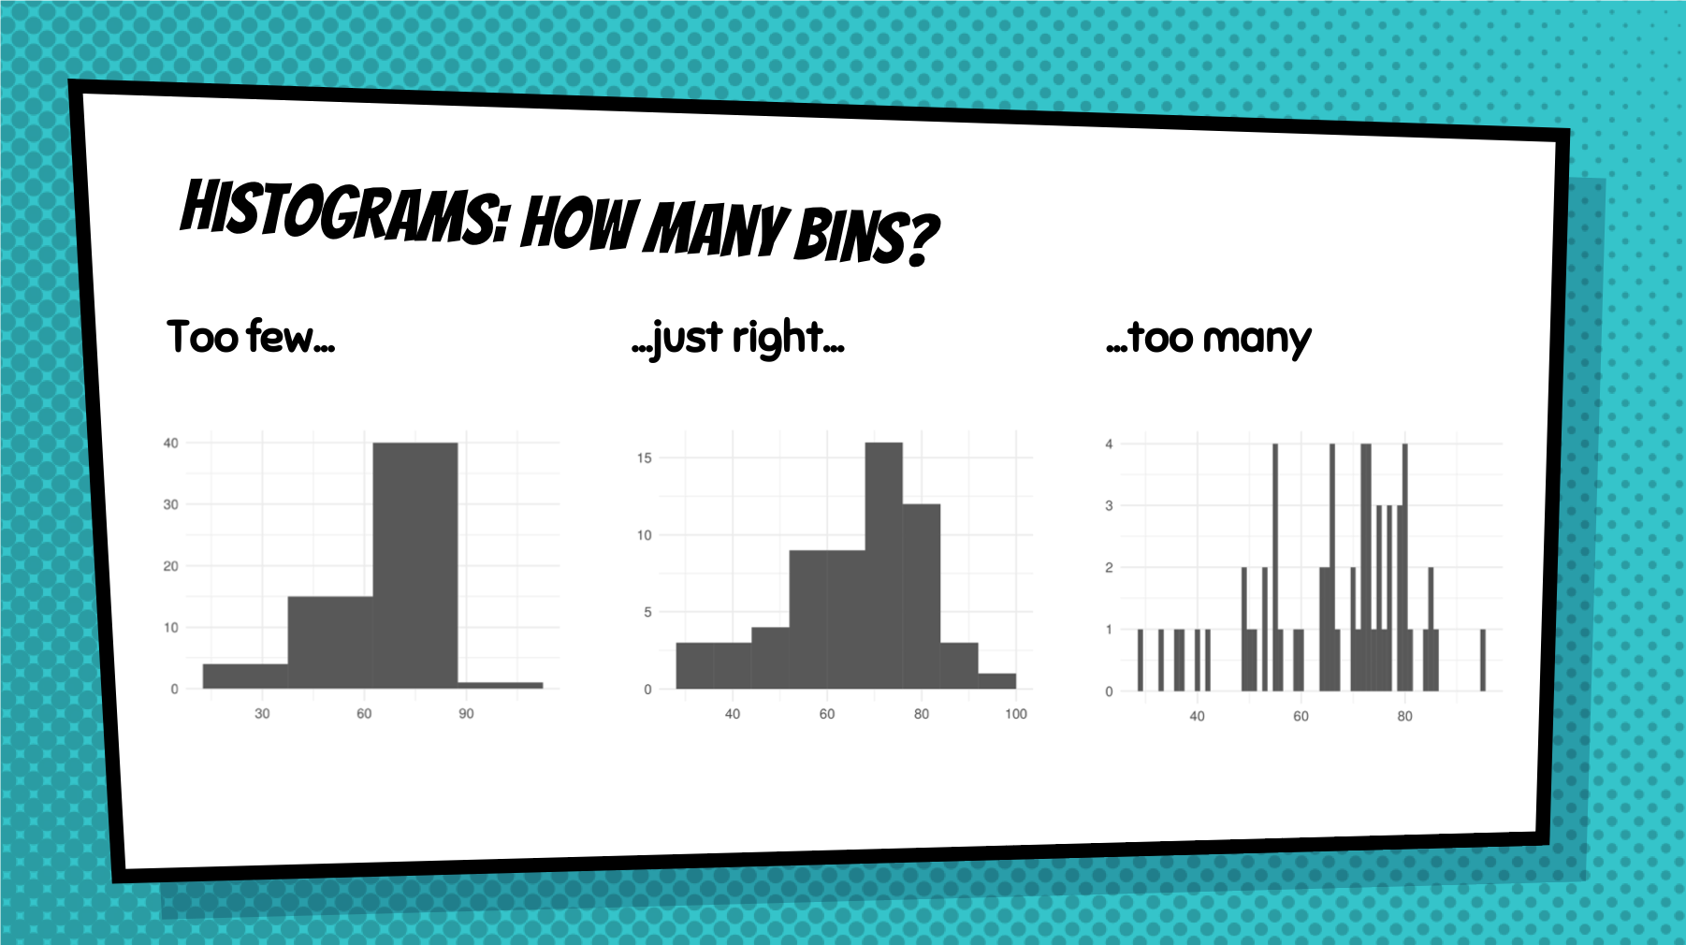

Slide 12
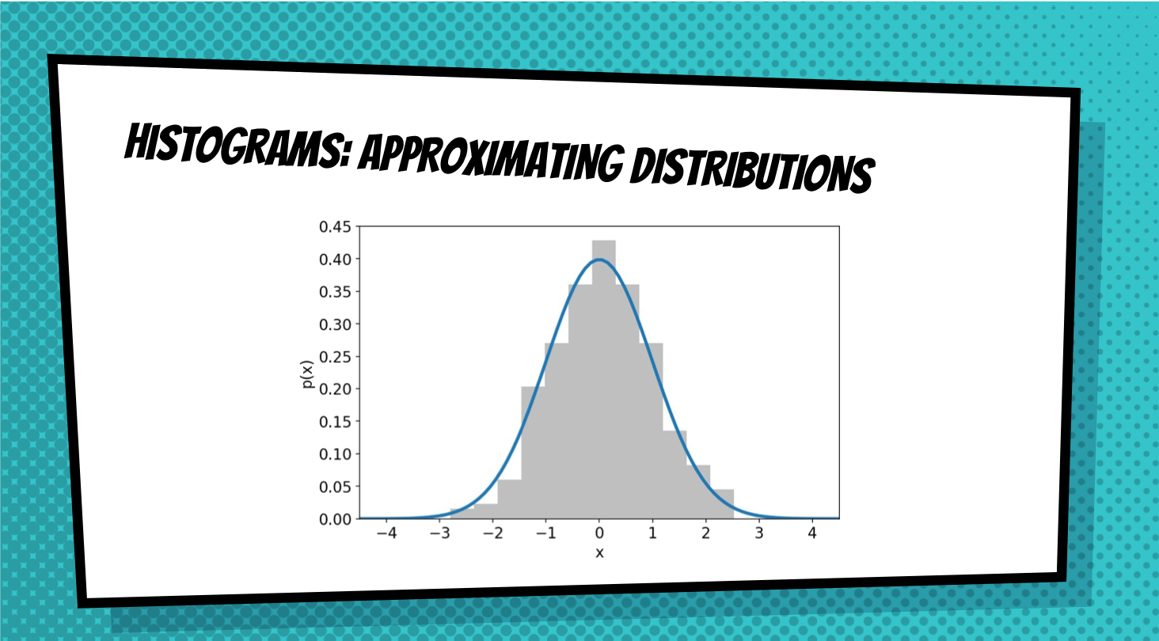

Slide 13
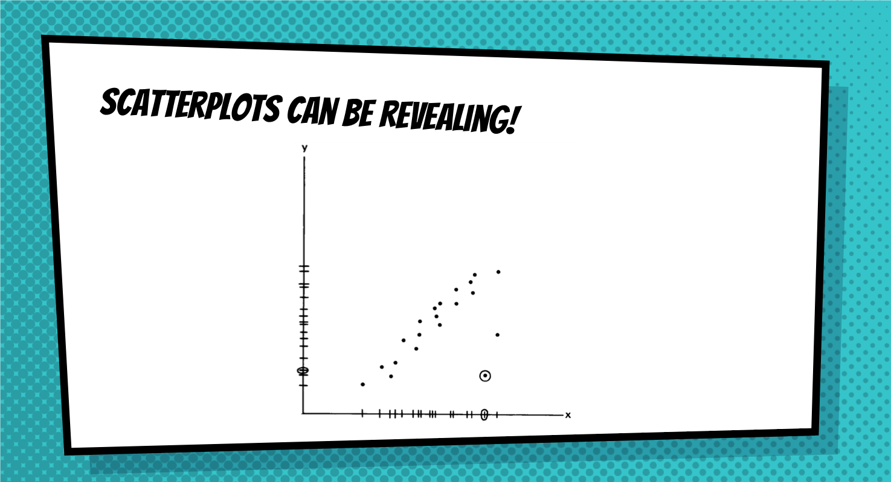

Slide 14
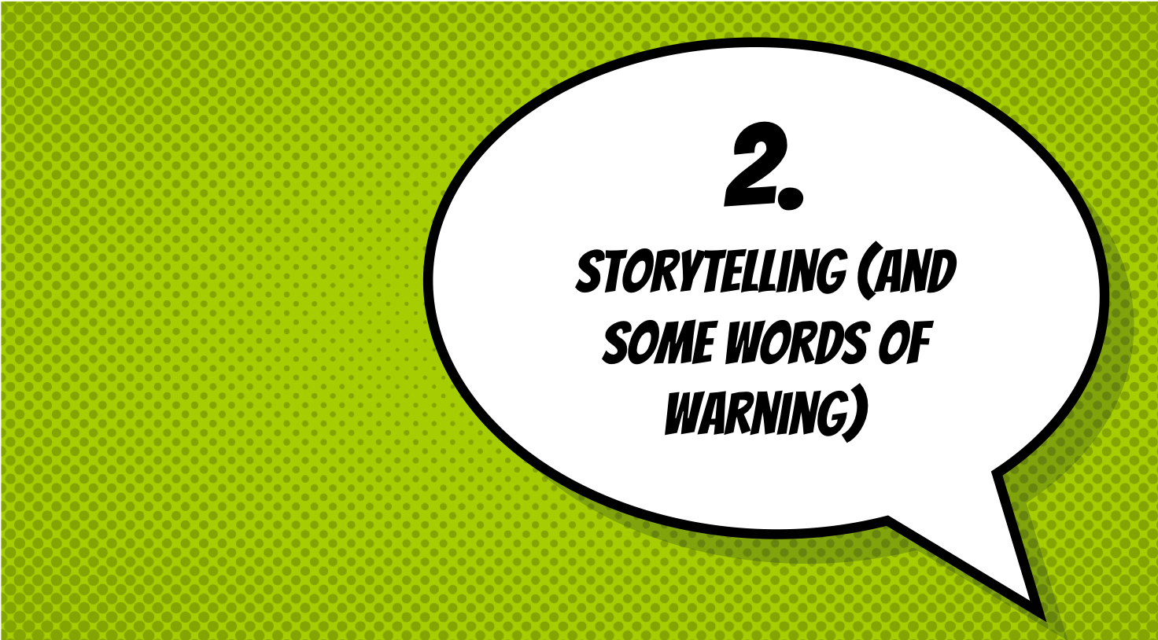

Slide 15


Slide 16
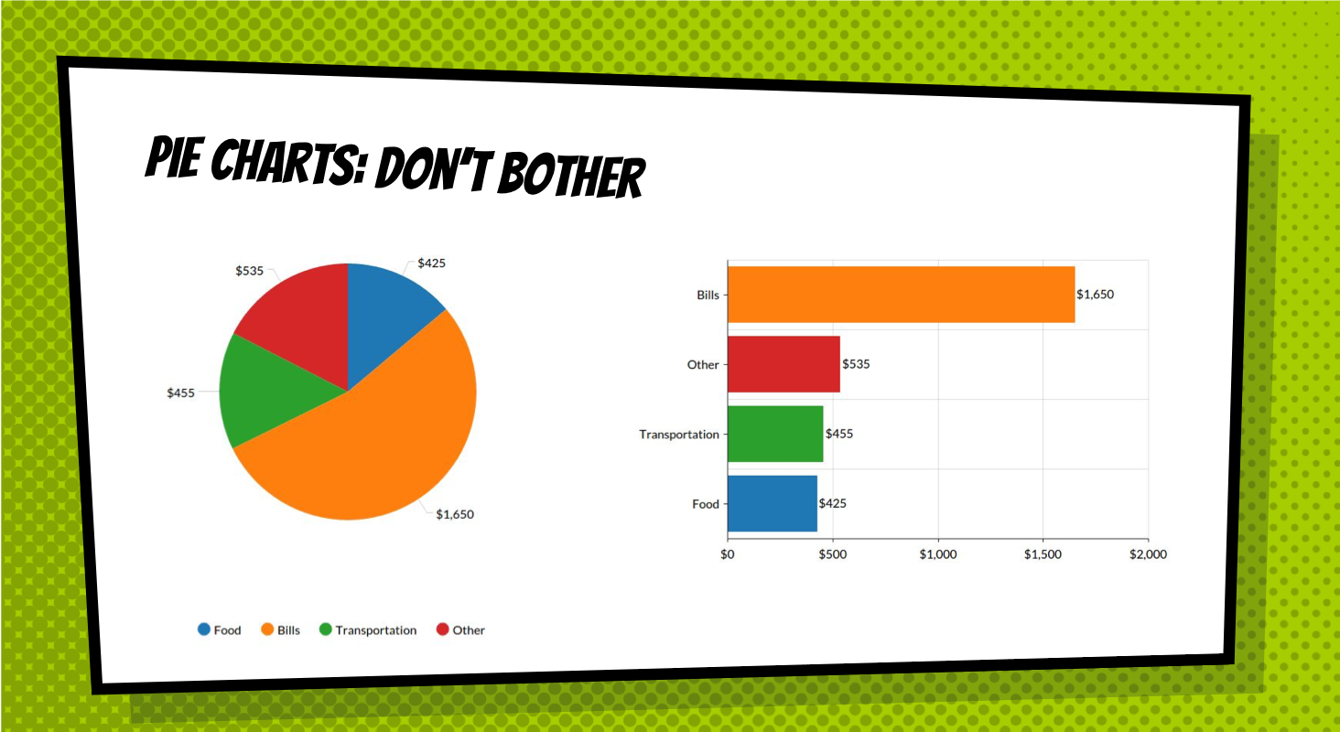

Slide 17
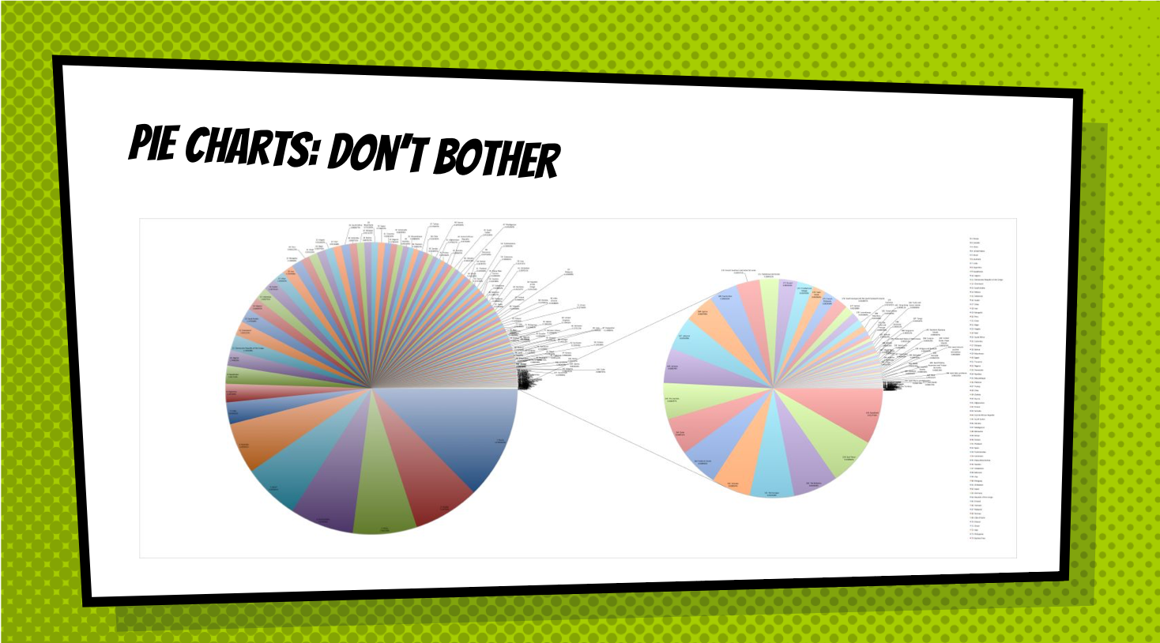

Slide 18
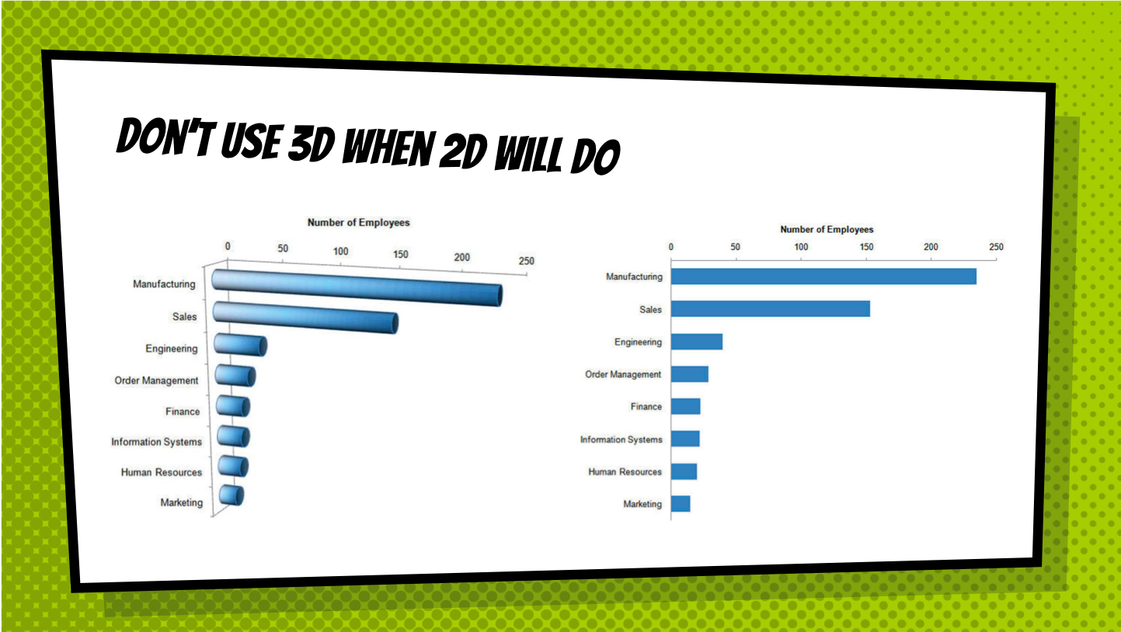

Slide 19
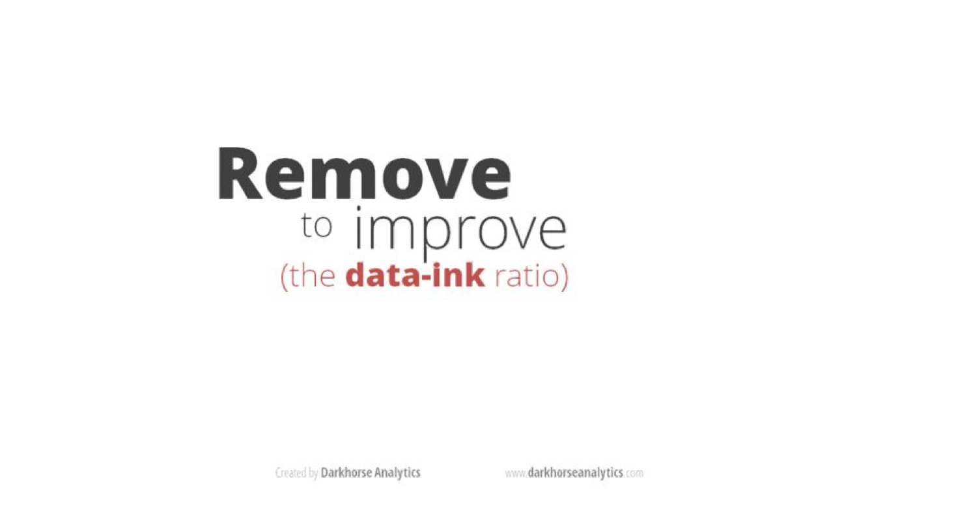

Slide 20
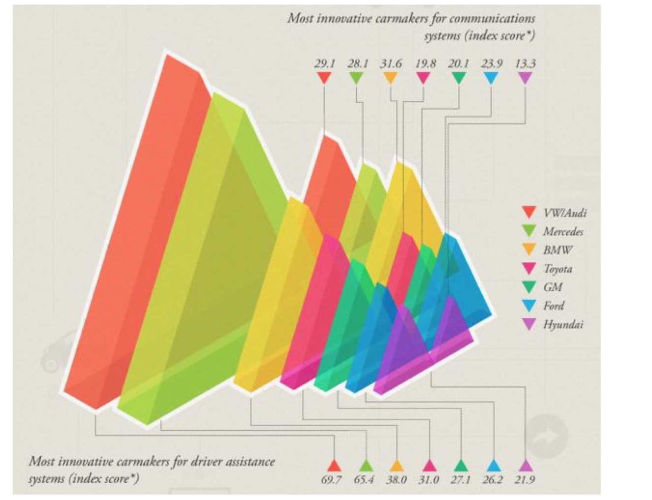

Slide 21


Slide 22
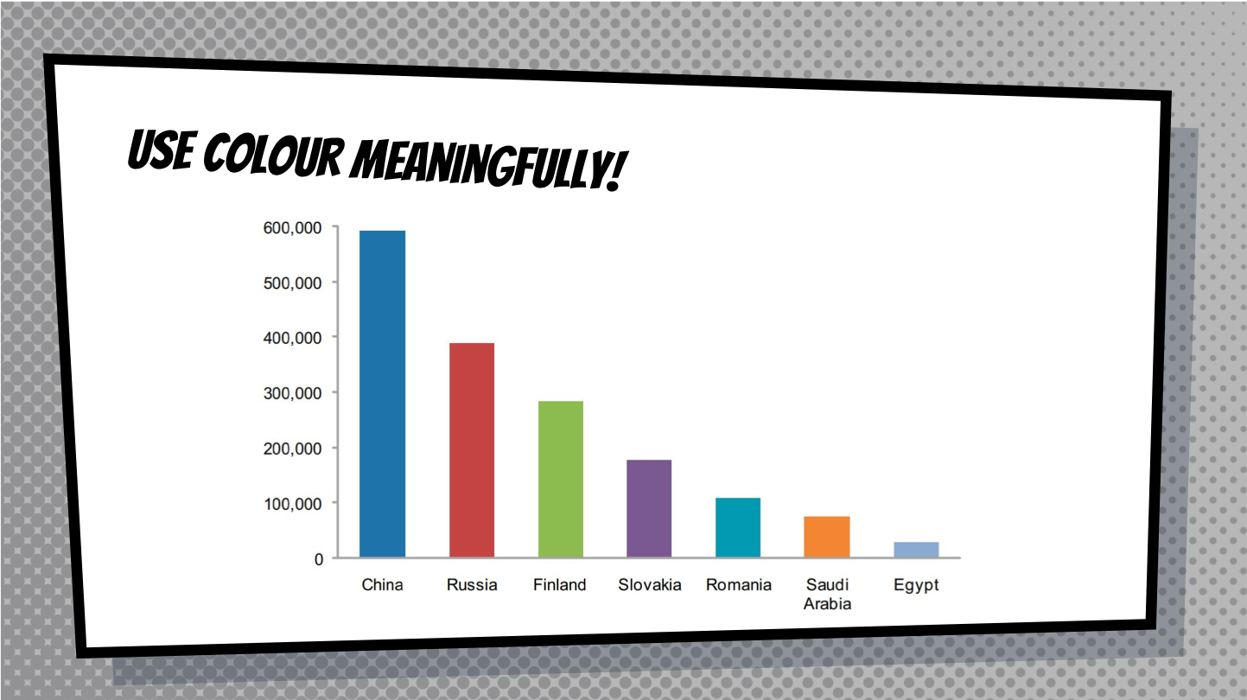

Slide 23
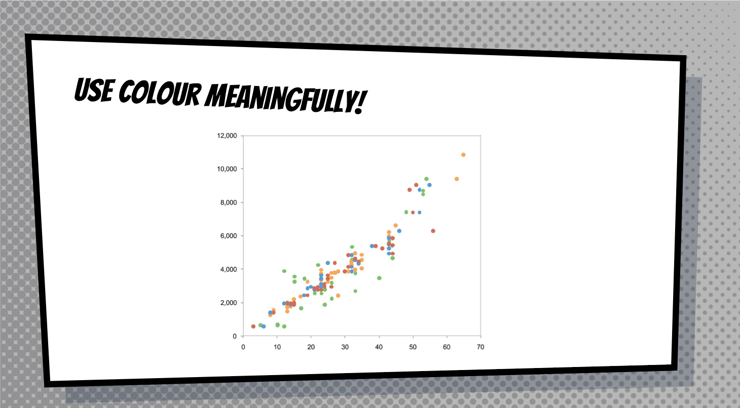

Slide 24
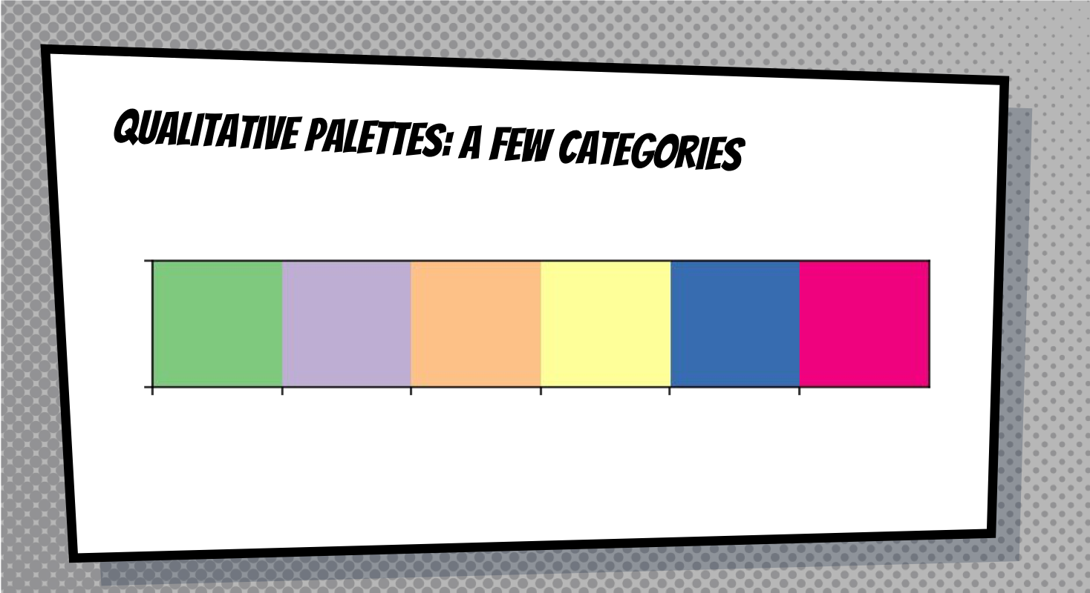

Slide 25
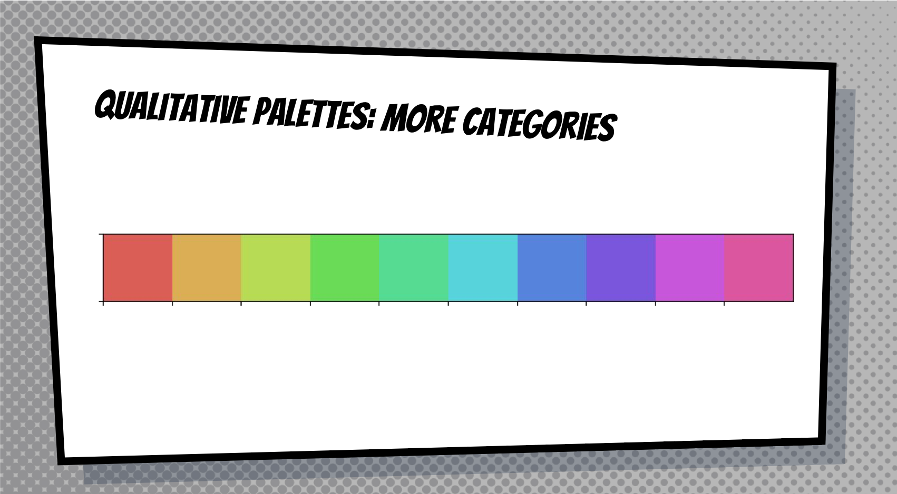

Slide 26
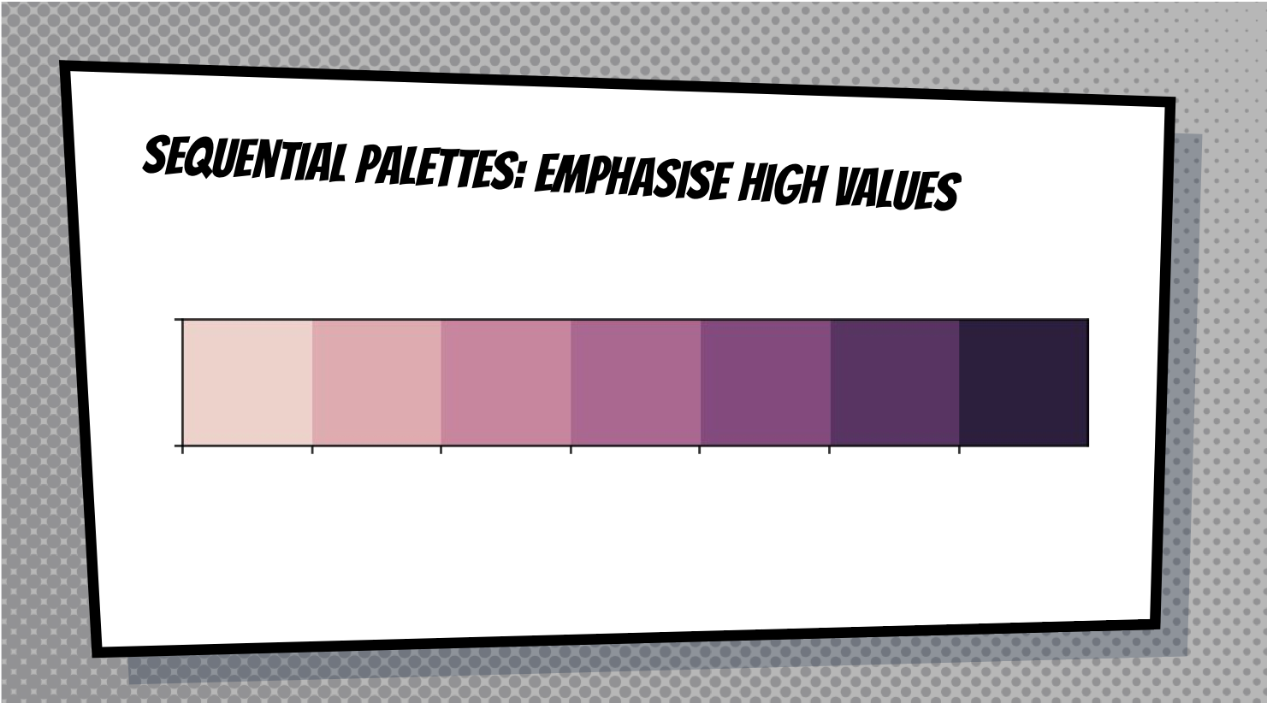

Slide 27
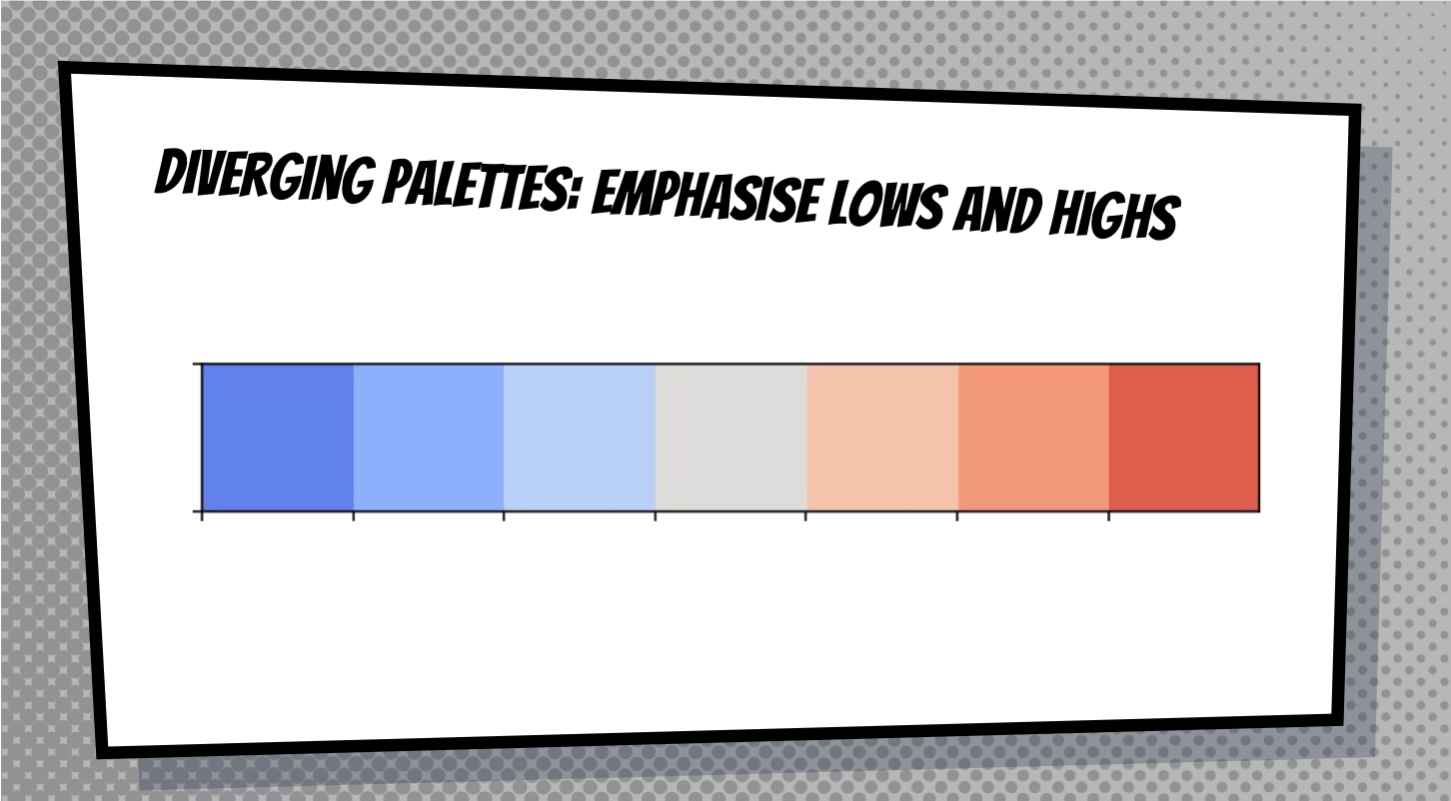

Slide 28
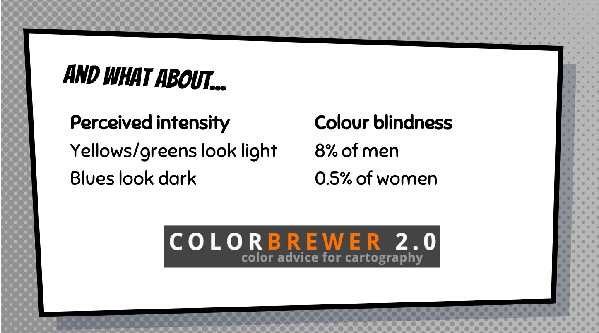

Slide 29
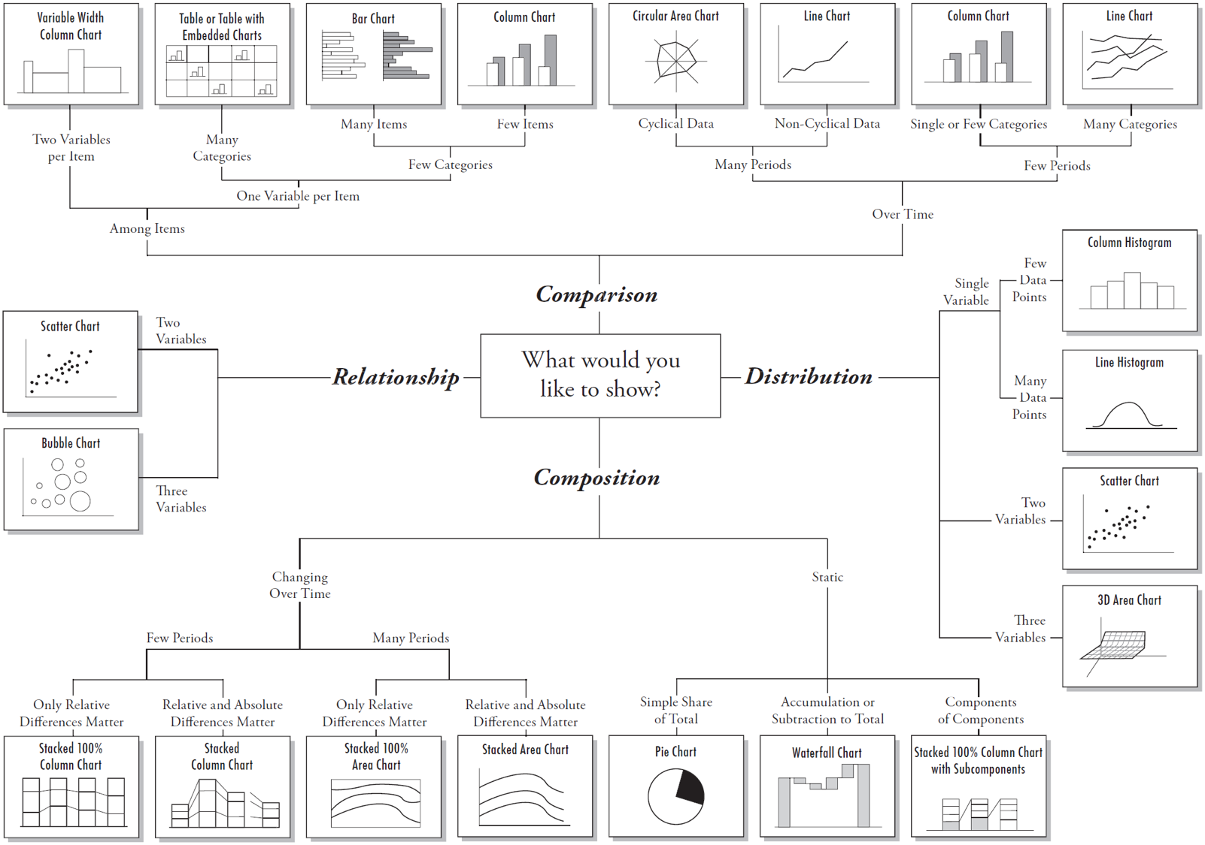
Notes:
Say that though you can’t see this ../Images properly, this image is in the handout.

Slide 30
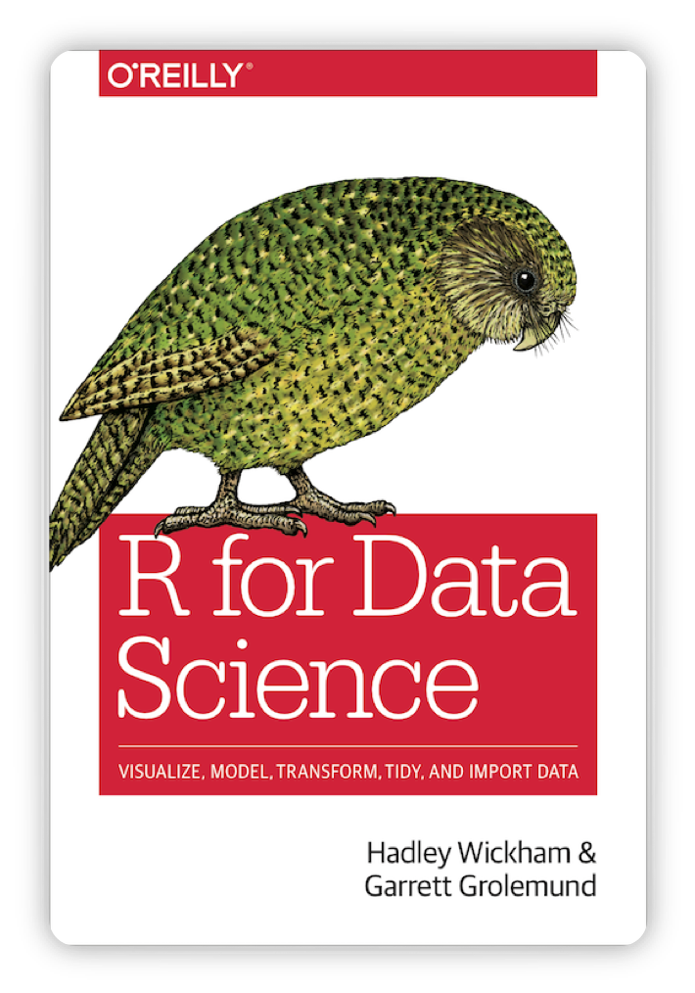
Visualising data in R
This book is helpful
Notes:
We now get to draw graphs!

Slide 31
There are many ways to plot graphs in R
Base R has visualisation commands
ggplot2 package (part of tidyverse):
Grammar of graphics - layered structure:
To load it now: library(ggplot2)

Slide 32
Structure of a ggplot command
It takes a while to get used to the structure.
There are different forms of syntax.
The base skeleton:
ggplot(data = df) + style_of_plot(mapping = aes(x = col_name_1, y = col_name_2))
Notes:
This will become more clear once we see examples

Slide 33
ggplot is very versatile
You use the same syntax structure to produce different types of graphs.
ggplot(data = df) + style_of_plot(mapping = aes(x = col_name_1, y = col_name_2)) + other_arguments
Notes:
Explain a couple of things you can add on using the + sign.

Slide 34
What is a ‘geom’?
A geom is a visual aspect of a graph.
dots
lines
bars
Look at the ggplot2 cheatsheet for more options.

Slide 35
Let’s create a line graph together
ggplot(data = cchic) + geom_smooth(mapping = aes(x = wbc, y = crp))
Notes:
Get them to type this code in and draw the graph. The graph they should get is on the next slide.

Slide 36
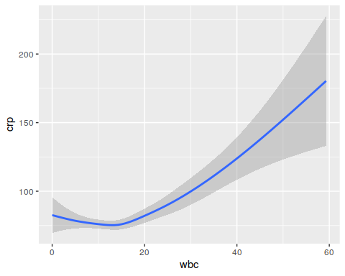

Slide 37
Adding a linetype
ggplot(data = cchic) + geom_smooth(mapping = aes(x = wbc, y = crp, linetype = sex))

Slide 38
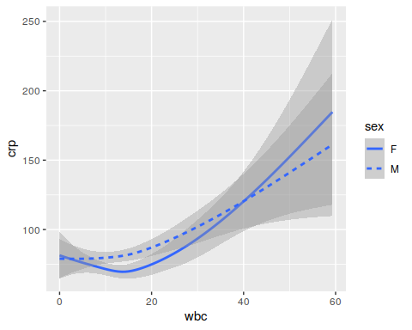

Slide 39
Adding colour
ggplot(data = cchic) + geom_smooth(mapping = aes(x = wbc, y = crp, colour = sex))

Slide 40
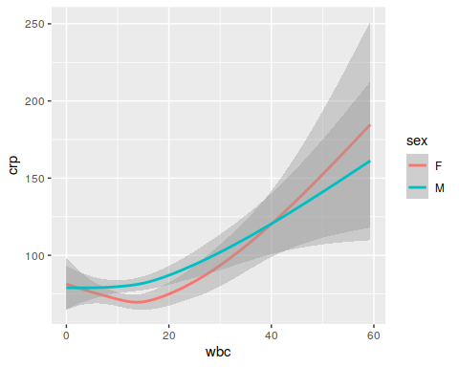

Slide 41
Combining multiple geoms
ggplot(data = cchic) + geom_point(mapping = aes(x = wbc, y = crp, colour = sex)) + geom_smooth(mapping = aes(x = wbc, y = crp))

Slide 42
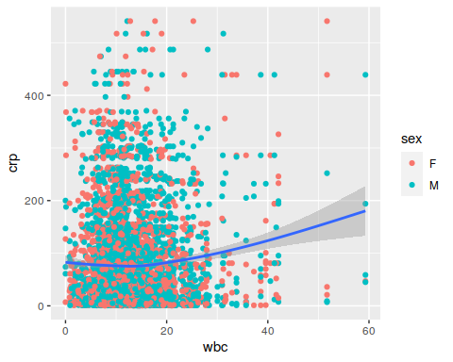

Slide 43
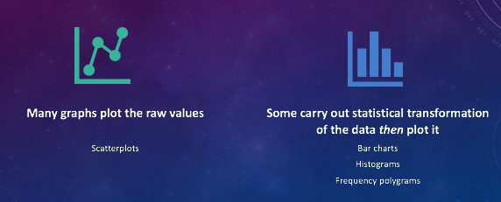
Bar Graph

Slide 44
Drawing a bar graph
ggplot(data = cchic) + geom_bar(mapping = aes(x = vital_status))

Slide 45
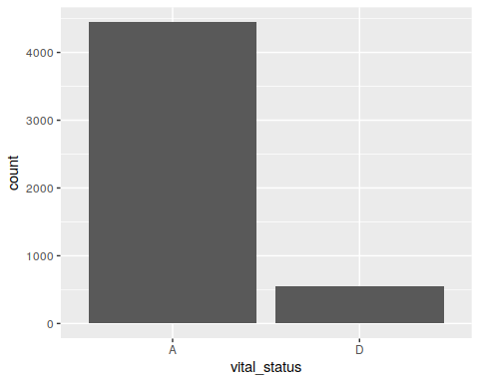

Slide 46
Adding a second aesthetic
ggplot(data = cchic) + geom_bar(mapping = aes(x = vital_status, fill = sex))

Slide 47
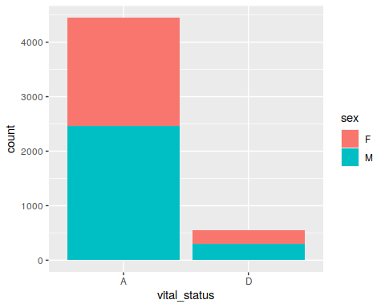

Slide 48
Standardising proportions
sex_vit_prop <- cchic %>% group_by(vital_status, sex) %>% summarize(n = n()) %>% mutate(n_total = sum(n), prop = n/n_total) ggplot(data = sex_vit_prop) + geom_col(mapping = aes(x = vital_status, y = prop, fill = sex))

Slide 49
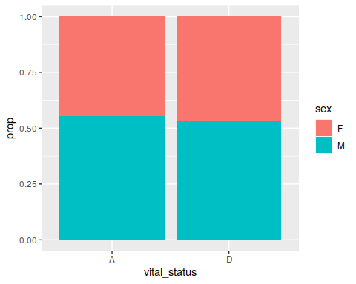

Slide 50
Changing position of bars
ggplot(data = sex_vit_prop) + geom_col(mapping = aes(x = vital_status, y = prop, fill = sex), position = "dodge")

Slide 51
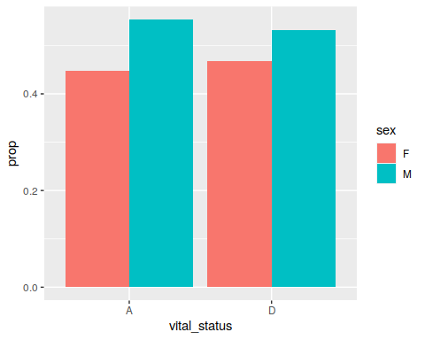

Slide 52
Scales and themes
Further modifications to the plot can be made through scales + themes functions
These can modify crucial aspects such as the limits of the axis using scales
To aesthetic features, such as the colour/axis titles.

Slide 53
Improving the x-axis labels
ggplot(data = sex_vit_prop) + geom_col(mapping = aes(x = vital_status, y = prop, fill = sex), position = "dodge") + scale_x_discrete(name = "Survival", labels = c(1, 0))

Slide 54


Slide 55
Improving the y-axis labels
ggplot(data = sex_vit_prop) + geom_col(mapping = aes(x = vital_status, y = prop, fill = sex), position = "dodge") + scale_x_discrete(name = "Survival", labels = c(1, 0)) + scale_y_continuous(name = "Proportion")

Slide 56
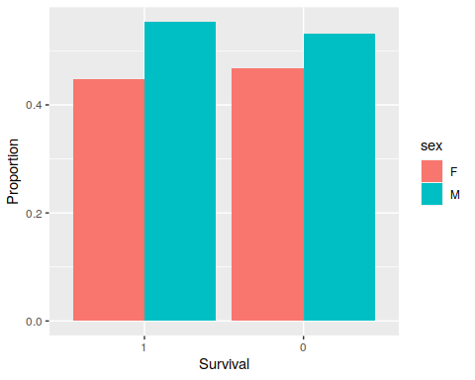

Slide 57
Improving the colours
ggplot(data = sex_vit_prop) + geom_col(mapping = aes(x = vital_status, y = prop, fill = sex), position = "dodge") + scale_x_discrete(name = "Survival", labels = c(1, 0)) + scale_y_continuous(name = "Proportion") + scale_fill_manual(name = "Gender", values = ggpubr::get_palette("jama", 2), labels = c("female", "male"))

Slide 58
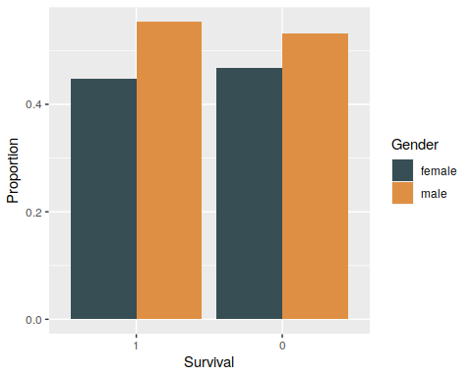

Slide 59
Changing the overall theme
ggplot(data = sex_vit_prop) + geom_col(mapping = aes(x = vital_status, y = prop, fill = sex), position = "dodge") + scale_x_discrete(name = "Survival", labels = c(1, 0)) + scale_y_continuous(name = "Proportion") + scale_fill_manual(name = "Gender", values = ggpubr::get_palette("jama", 2), labels = c("female", "male")) + theme_bw()

Slide 60
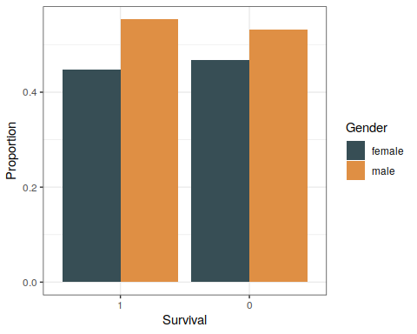

Slide 61
Practice
Open up the R script called Workshop5.R.
Run through the commands in it.
Make an expectation for each plot, before command is run. How does this compare to the actual plot?
Extra: how would I save a plot?

Slide 62
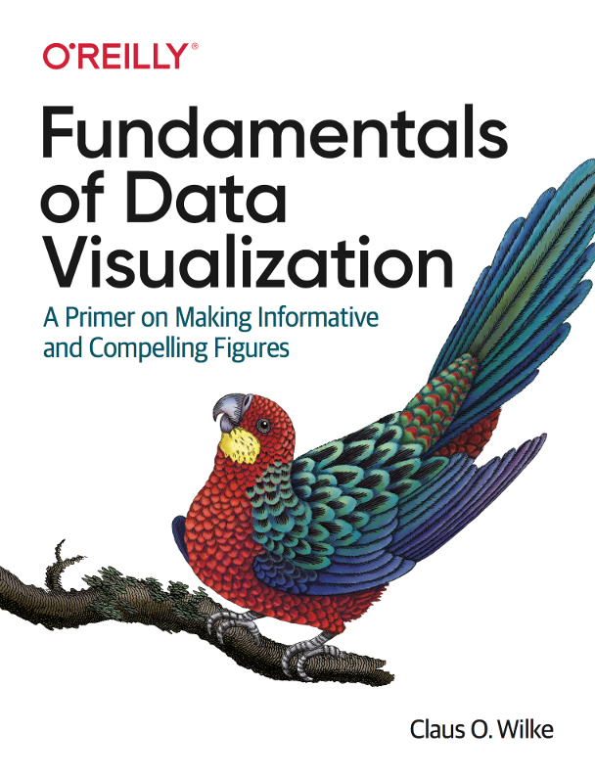
Useful resources
ggplot cheatsheet
ggpubr
Fundamentals of Data Visualization

Slide 63
Create your own plots now!

